Slide 1
Struts 2
Java Team Training
September 2013

Slide 2
Objectives of Struts 2
Purpose:
Understand Struts Framework fundamentals, advantages, architecture, mapping and configuration
Product:
Understanding of Struts 2 Framework and its application
Knowledge on how to create Web Application Project using Struts
Create KnowledgeCheck Project using Struts 2 Framework, Hibernate, Tiles and Maven
Process:
Theory discussions followed by hands-on exercises

Slide 3
Topics of Struts 2
Day 1:
-MVC Architecture
-Struts 2 Overview
-Advantages/Disadvantages
-Struts 1 vs Struts 2
-Struts 2 Architecture and Request Lifecycle
-Configuration Files
-Action
-Interceptors
-Result & Result Types
Day 2:
-Value Stack/OGNL
-Validations Framework
-Type Conversion
-Exception Handling
-Struts Annotations
-Struts Tags
-Struts-Hibernate/Tiles Integration
Day 3:
-KnowledgeCheck Project – build additional functionalities using integration of
Struts, Hibernate, Tiles

Slide 4
MVC Architecture
A software architecture pattern to separate business/application logic from user interface layer
Model
-Manage data of the application
-Responds to View’s request
-Notify View with the changes
View
-Presents data in
particular format
-Renders Model data into a form
-Sends user gestures to
Controller
Controller
-Handles request from View
-Maps user action
to Model updates
Notes:
MVC is a classical design pattern used in applications who needs a clean separation between their business logic and view who represents data. Divided into three parts:
Model
The model is responsible for managing the data of the application. It responds to the request from the view and it also responds to instructions from the controller to update itself.
View
A presentation of data in a particular format, triggered by a controller's decision to present the data. They are script based templating systems like JSP, ASP, PHP and very easy to integrate with AJAX technology.
Controller
The controller is responsible for responding to user input and perform interactions on the data model objects. The controller receives the input, it validates the input and then performs the business operation that modifies the state of the data model.

Slide 5
Struts 2 Overview
Struts2 is a Web Application Framework based on MVC design pattern
Designed to streamline the full development cycle, from building, to deploying, to maintaining applications over time
Goal is to separate Model from the View and the Controller
Originally developed by Craig McClanahan and donated to the Apache Foundation in May 2000
Notes:
Apache Struts 2 is an elegant, extensible framework for creating enterprise-ready Java web applications. The framework is designed to streamline the full development cycle, from building, to deploying, to maintaining applications over time. Apache Struts 2 was originally known as WebWork 2.
It uses and extends the Java Servlet API to encourage developers to adopt a model–view–controller (MVC) architecture.
The goal of Struts is to separate the model (application logic that interacts with a database) from the view (HTML pages presented to the client) and the controller (instance that passes information between view and model). Struts provides the controller (a servlet known as ActionServlet) and facilitates the writing of templates for the view or presentation layer (typically in JSP, but XML/XSLT and Velocity are also supported). The web application programmer is responsible for writing the model code, and for creating a central configuration file struts-config.xml that binds together model, view, and controller.

Slide 6
Advantages and Disadvantages
Advantages:
POJO Forms and Actions
Tag Support
AJAX Support
Easy Integration
Template Support
Plugin Support
Profiling
Easy to modify tags
Promote less configuration
Supports multiple View Technologies
Disadvantages:
Bigger learning curve
Poor documentation
Less transparent
Notes:
ADVANTAGES:
POJO forms and POJO actions - Struts2 has done away with the Action Forms that were an integral part of the Struts framework. With Struts2, you can use any POJO to receive the form input. Similarly, you can now see any POJO as an Action class.
Tag support - Struts2 has improved the form tags and the new tags allow the developers to write less code.
AJAX support - Struts2 has recognised the take over by Web2.0 technologies, and has integrated AJAX support into the product by creating AJAX tags, that function very similar to the standard Struts2 tags.
Easy Integration - Integration with other frameworks like Spring, Tiles and SiteMesh is now easier with a variety of integration available with Struts2.
Template Support - Support for generating views using templates.
Plugin Support - The core Struts2 behaviour can be enhanced and augmented by the use of plugins. A number of plugins are available for Struts2.
Profiling - Struts2 offers integrated profiling to debug and profile the application. In addition to this, Struts also offers integrated debugging with the help of built in debugging tools.
Easy to modify tags - Tag markups in Struts2 can be tweaked using Freemarker templates. This does not require JSP or java knowledge. Basic HTML, XML and CSS knowledge is enough to modify the tags.
Promote less configuration - Struts2 promotes less configuration with the help of using default values for various settings. You don't have to configure something unless it deviates from the default settings set by Struts2.
View Technologies - Struts2 has a great support for multiple view options (JSP, Freemarker, Velocity and XSLT)
DISADVANTAGES:
Bigger learning curve - To use MVC with Struts, you have to be comfortable with the standard JSP, Servlet APIs and a large & elaborate framework.
Poor documentation - Compared to the standard servlet and JSP APIs, Struts has fewer online resources, and many first-time users find the online Apache documentation confusing and poorly organized.
Less transparent - With Struts applications, there is a lot more going on behind the scenes than with normal Java-based Web applications which makes it difficult to understand the framework.

Slide 7
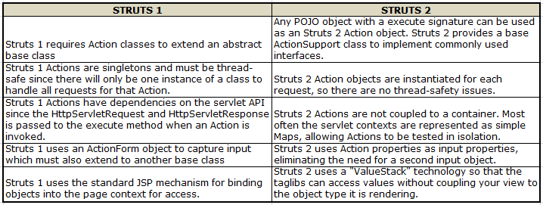
Struts 1 vs Struts 2
Can refer to Struts Docu (mentation for complete list of comparison between Struts 1 and 2 (http://struts.apache.org/release/2.1.x/docs/comparing-struts-1-and-2.html)
Notes:
Struts 1 vs Struts 2: http://struts.apache.org/release/2.1.x/docs/comparing-struts-1-and-2.html

Slide 8
Struts 1.x Architecture
struts-config
Action
Form
User
ActionServlet
Database
JSP
(View)
Model
Beans
Notes:
ActionServlet works with RequestProcessor and ActionMapping to implement the Controller. ActionServlet delegates the Action lookup to the RequestProcessor. RequestProcessor contains the processing logic that the ActionServlet performs as it receives each servlet request from the container.
During startup, ActionServlet is loaded (configured in deployment descriptor web.xml). It reads struts-config.xml for the details of Action, ActionForms, ActionMapping and ActionForward and creates the Database Objects.
User sends requests (Browser issue http request) to ActionServlet
ActionServlet bundles request values to the equivalent Java Beans (which extends Struts ActionForm)
It then refers to the struts-config to decide which Action class to invoke and validate the data entered by the user
Action class process the request referring to the Model Beans that connects to the database
After processing, Action class returns ActionForward to the Controller and based on this, the appropriate view will be invoked
HTTP response is then returned to the user thru the View Component

Slide 9
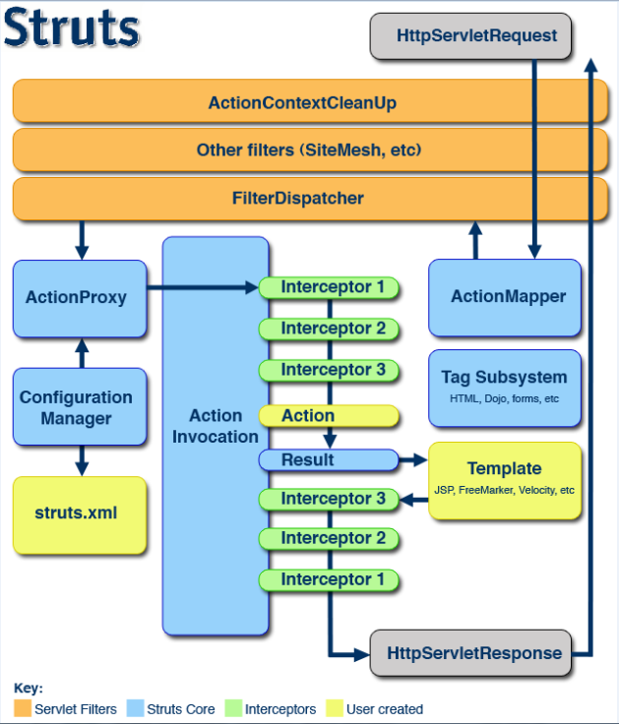
Struts 2 Architecture
Notes:
Image from: http://struts.apache.org/release/2.0.x/docs/architecture.html
Initial Request goes to the Servlet Container which is passed through a standard filter chain
The chain can include ActionContextCleanUp (optional) to integrate other technologies (e.g. SiteMesh)
The filter FilterDispatcher (Deprecated since Struts 2.1.3) or StrutsPrepareAndExecuteFilter is then called to consult with the ActionMapper to check if request should invoke an action
Once ActionMapper determines that an Action should be invoked, the filter will then delegate the control to the ActionProxy
ActionProxy then verify with the Configuration Manager (initialized from the struts.xml file) and create an ActionInvocation instance
ActionInvocation implements the command pattern including invoking Interceptors prior the Action itself
Once Action is returned, ActionInvocation will lookup the Result Code mapped in struts.xml
Result is then executed which can involve a template written in JSP, FreeMaker, etc to be rendered. Struts tags provided by the Framework can be used by these templates as well.
Interceptors are once again executed/invoked for post-processing
Response is then returned to the filters in web.xml which will send back the result to the Servlet Container then to the client

Slide 10
Request Lifecycle
Request generated by the user
StrutsPrepareAndExecuteFilter (FilterDispatcher deprecated) then determines the equivalent Action
Interceptors (if applicable) are applied before calling the Action
Action is executed and Result is generated
Interceptors are again applied to perform any post-processing if required
Action is then rendered in the View (e.g. JSP) and result returned to the user
ACTION
RESULT
INTERCEPTORS
JSP
user.action
Notes:
(1) Request is generated by user and sent to Servlet container.
(2) Container then invokes FilterDispatcher/StrutsPrepareAndExecuteFilter filter which in turn determines appropriate Action.
(3) Interceptors are applied before calling the Action. Interceptors performs tasks such as Logging, Timer, Validation, File Upload, etc.
(4) Action is executed and the Result is generated by Action.
(5) The output of Action is rendered in the view (e.g. HTML, JSP) and the result is returned to the user.

Slide 11
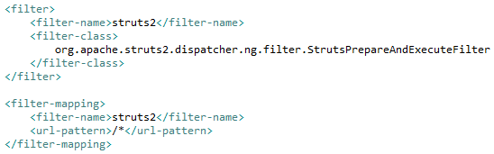
Struts 2 Configuration Files
web.xml (deployment descriptor)
A J2EE configuration file that determines how elements of the HTTP request are processed by the servlet container
Serves as the entry point of any Web Application
Struts 2 Entry point is a filter defined on web.xml
Notes:
Struts Servlet Filter Class:
(1) org.apache.struts2.dispatcher.FilterDispatcher – deprecated since Struts 2.1.3
(2) org.apache.struts2.dispatcher.ng.filter.StrutsPrepareAndExecuteFilter
- Handles both the preparation and execution phases of the Struts dispatching process
config - a comma-delimited list of XML configuration files to load.
actionPackages - a comma-delimited list of Java packages to scan for Actions.
configProviders - a comma-delimited list of Java classes that implement the ConfigurationProvider interface that should be used for building the Configuration.
loggerFactory - The class name of the LoggerFactory implementation.
* - any other parameters are treated as framework constants.
<filter>
<filter-name>struts2</filter-name>
<filter-class>org.apache.struts2.dispatcher.ng.filter.StrutsPrepareAndExecuteFilter</filter-class>
<init-param>
<param-name>actionPackages</param-name>
<param-value>com.struts.tutorial.action</param-value>
</init-param>
</filter>

Slide 12
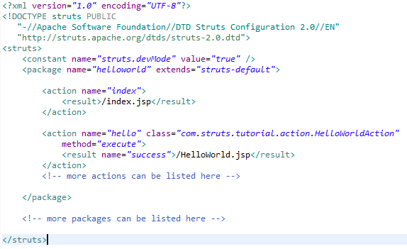
Struts 2 Configuration Files
struts.xml
Contains configuration information that will be modified as actions are developed (usually located at WEB-INF/classes)
Notes:
All struts configuration file need to have the correct DOCTYPE.
<struts> is the root tag element, under which we declare different packages using <package> tags. <package> allows separation and modularization of the configuration
<package> attributes:
name (required) - The unique identifier for the package
extends – Indicates which package does this package extend from. By default, we use struts-default as the base package.
abstract - If marked true, the package is not available for end user consumption.
namesapce - Unique namespace for the actions
<constant> - used to override settings like the maximum file upload size or whether the Struts framework should be in "devMode" or not
<action> corresponds to every URL we want to access and we define a class with execute() method which will be accessed whenever we will access corresponding URL. name attribute is matched as part of the location requested by a browser (or other HTTP client).
<result> - determines what gets returned to the browser after an action is executed. String returned from the Action should match the name attribute of the result
Struts.xml can be divided into multiple xml files. Below sample on how to split and import:
<struts> <include file="my-struts1.xml"/> <include file="my-struts2.xml"/> </struts>

Slide 13
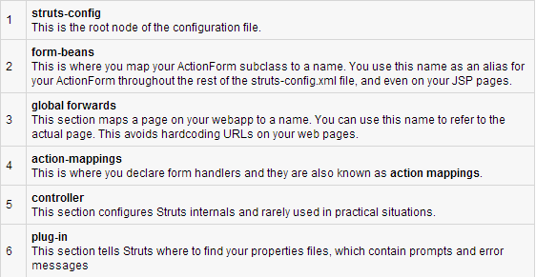
Struts 2 Configuration Files
struts-config.xml
a link between the View and Model components in the Web Client

Slide 14

Struts 2 Configuration Files
struts.properties (usually located at WEB-INF/classes)
Provides a mechanism to change the default behavior of the framework
Properties defined in this file can also be configured in web.xml using <init-param> and in struts.xml using <constant>
The values in this file will also override the values in default.properties which is contained in struts-core.x.y.z.jar distribution
Notes:
struts-default.xml - this file contains the standard configuration settings for Struts which is also contained in struts-core.x.y.z.jar distribution

Slide 15
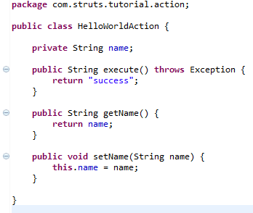
Struts 2 Action
The core of Struts 2 Framework that handles transfer of data from the request through to the view, whether its a JSP or other type of result
There must be one no-argument method that returns either a String or Result object and must be a POJO (if no-argument method is not specified, execute() is used)

Slide 16
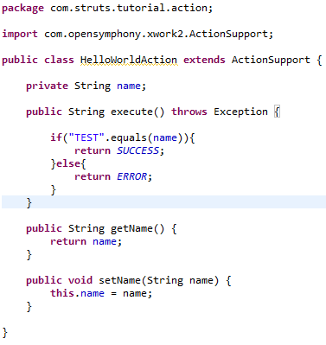
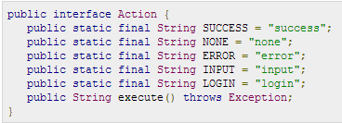
Struts 2 Action
Can optionally extend ActionSupport class which implements six interfaces including Action interface
com.opensymphony.xwork2.Action interface

Slide 17
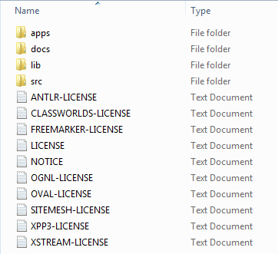
Environment Setup
Set JAVA_HOME (JDK Path) in Environment Variables
Apache Tomcat
Eclipse IDE
Struts 2 Libraries
Download latest distribution from http://struts.apache.org/download.cgi
Extract in any directory

Slide 18
Struts 2 Interceptors
Interceptors allow for crosscutting functionality to be implemented separately from the action as well as the framework
Features like double-submit guards, type conversion, object population, validation, file upload, page preparation, and more, are all implemented with the help of Interceptors
Interceptors "set the stage" for the Action classes, doing much of the "heavy lifting" before the Action executes
Notes:
Interceptors are responsible for most of the request processing. They are invoked by the controller before and after invoking action, thus they sits between the controller and action. Interceptors performs tasks such as Logging, Validation, File Upload, Double-submit guard etc.
Framework creates an object of ActionInvocation that encapsulates the action and all the interceptors configured for that action. Each interceptors are called before the action gets called. Once the action is called and result is generated, each interceptors are again called in reverse order to perform post processing work. Interceptors can alter the workflow of action. It may prevent the execution of action.

Slide 19
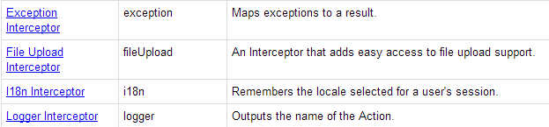
Struts 2 Interceptors
struts-default.xml provides list of Interceptors preconfigured and ready to use when struts-default package is extended
Some Struts 2 Framework Interceptors
Notes:
struts-default.xml - this file contains the standard configuration settings for Struts which is also contained in struts-core.x.y.z.jar distribution

Slide 20
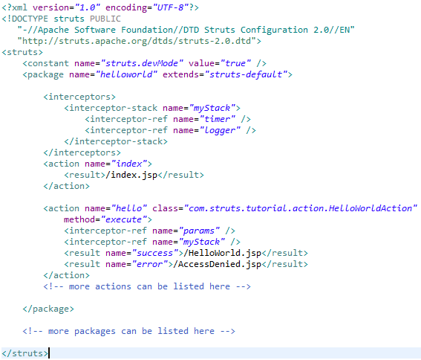
Struts 2 Interceptors
Configuration and Stacking
Notes:
The interceptor-stack element is used to create an interceptor stack. A stack contains a group of interceptors. Each interceptor in the stack is defined using the interceptor-ref element.

Slide 21
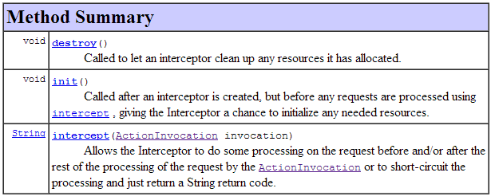
Struts 2 Interceptors
Customizing Interceptors
Implement Interceptor interface
Extend any known implementing class of Interceptor interface e.g. AbstractInterceptor
Interface Interceptor
Notes:
Class AbstractInterceptor
- Provides default implementations of optional lifecycle methods
- Method Summary
void destroy() – Does nothing
void init() – Does nothing
abstract String intercept(ActionInvocation invocation) – Override to handle interception

Slide 22
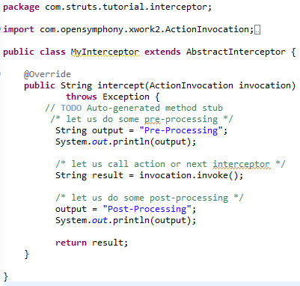
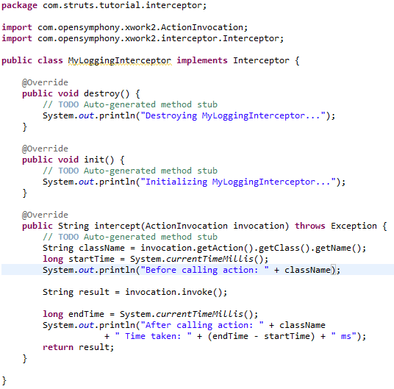
Struts 2 Interceptors

Slide 23
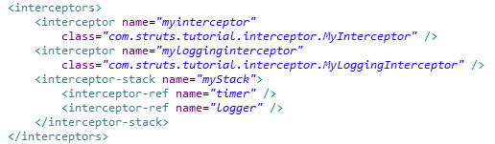
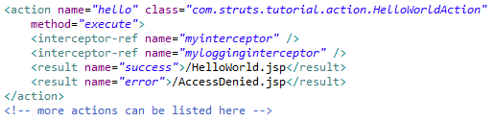
Struts 2 Interceptors
struts.xml

Slide 24
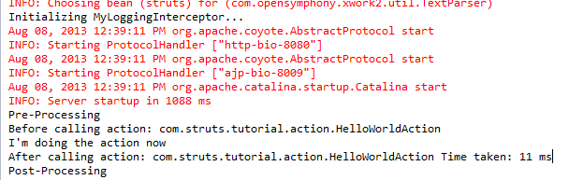
Struts 2 Interceptors
Interceptors are called before the action gets called > Action called, result generated > interceptors are again called in reverse order to perform post processing work

Slide 25

Struts 2 Results and Result Type
<results> tag plays the role of a view in the Struts2 MVC framework
dispatcher Result Type
default result type used to dispatch to a Servlet, JSP, HTML pages
Uses RequestDispatcher.forward() method
Notes:
FreeMarker is a "template engine"; a generic tool to generate text output (anything from HTML to autogenerated source code) based on templates. It's a Java package, a class library for Java programmers. It's not an application for end-users in itself, but something that programmers can embed into their products.

Slide 26



Struts 2 Results and Result Type
freemaker Result Type
FreeMaker is a templating engine
redirect Result Type
calls the standard response.sendRedirect() method

Slide 27
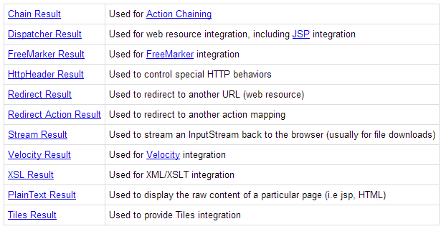
Struts 2 Results and Result Type
http://struts.apache.org/release/2.1.x/docs/result-types.html

Slide 28
Struts 2 Example and Exercise
Demo
IDE: Eclipse, Web Server: Tomcat, JDK 1.7.0_25, Maven
Steps:
Create Web Project using Maven > Convert to Eclipse Project
Import Project in Eclipse
Update web.xml
Create struts.xml
Create JSPs
Create Action Class
Update struts with appropriate package and actions
Compile/Package > Run in Tomcat
Add Interceptors and Result/Result Types > Run in Tomcat
Exercise

Slide 29
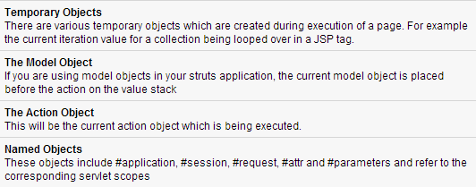
Struts 2 Value Stack/OGNL
ValueStack is a set of several objects that keeps the following objects (in the same order provided below)
ValueStack can be accessed via tags provided for JSP, Velocity or FreeMaker
In Action classes, ActionContext.getContext().getValueStack()

Slide 30
Struts 2 Value Stack/OGNL
Object-Graph Navigation Language (OGNL) is a powerful expression language that is used to reference and manipulate data on the ValueStack
Similar to JSP Expression Language and based on the idea of having a root or default object within the context
OGNL is based on a context and Struts builds an ActionContext map for use with OGNL

Slide 31
Struts 2 Value Stack/OGNL
ActionContext map consists of the following:
application - application scoped variables
session - session scoped variables
root / value stack - all your action variables are stored here
request - request scoped variables
parameters - request parameters
atributes - the attributes stored in page, request, session and application scope
Objects in the ActionContext are referred using the # symbol, however, the objects in the value stack can be directly referenced
Notes:
Action object is always available in the value stack. Therefore, if Action object has properties x and y there are readily available for you to use.

Slide 32
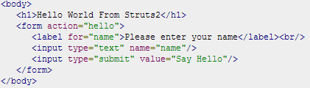
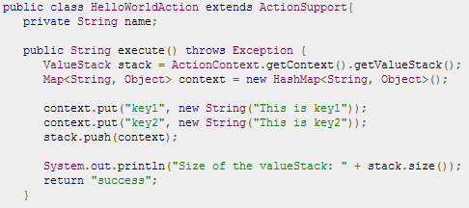

Struts 2 Value Stack/OGNL
form with text
input “name”
Inject key1,
key2
in ValueStack
access key1, key2
using property tag
Notes:
The usual way to put stuff on the Value Stack is to add getters/setters for the values to your Action class and then use <s:property> tag to access the values.

Slide 33
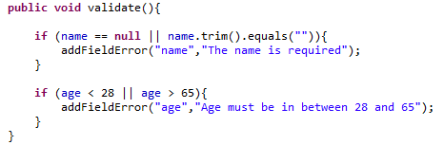
Struts 2 Validations Framework
Struts Validation Framework assists the application to run rules to perform validation before Action method is executed
validate() method in Action class
Action class must extend ActionSupport which implements Validateable interface
Notes:
Client side validation is usually achieved using Javascript.
Struts Action 2 relies on a validation framework provided by XWork to enable the application of input validation rules to your Actions before they are executed. Struts2 Validation Framework allows us to separate the validation logic from actual Java/JSP code, where it can be reviewed and easily modified later.

Slide 34
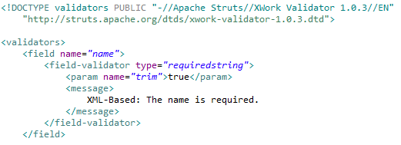
Struts 2 Validations Framework
XML-based Validation
Provides more options of validation like email validation, integer range validation, form validation field, expression validation, regex validation, required validation, requiredstring validation, stringlength validation and etc
Must be named [action-class]-validation.xml and ideally, should be in the CLASSPATH same as the class file
Notes:
Struts 2.0.7 and Prior The validators.xml containing custom validators needs to contain a copy of the default validators.
There are two types of Validators in Struts2 Validation Framework:
(1) Field Validators - act on single fields accessible through an action. This should be preferred over non-field validation wherever possible, as field validator messages are bound to the related field and will be presented next to the corresponding input element in the respecting view.
(2) Non-field validators - only add action level messages. Mostly domain specific and therefore offer custom implementations

Slide 35
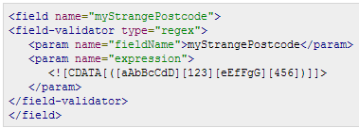
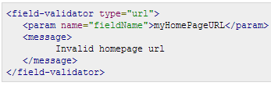
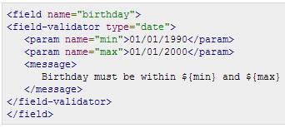
Struts 2 Validations Framework
Bundled Validators
conversion validator
date validator
double validator
email validator
expression validator
fieldexpression validator
int validator
regex validator
required validator
requiredstring validator
stringlength validator
url validator
visitor validator
Notes:
Custom Validation logic – implement com.opensymphony.xwork2.validator.Validator and plug into validation framework as a re-usable component

Slide 36
Struts 2 Type Conversion
Protocol treats all HTTP request as a String (including numbers, boolean, integers, dates, decimals, etc)
Struts does the heavy lifting and uses variety of type converters to automatically convert request parameter to the desired type (e.g. Integer)
Some Struts default Type Converters
Integer, Float, Double, Decimal, Date, Datetime, Arrays, Collections, Enumerations, Boolean, BigDecimal

Slide 37
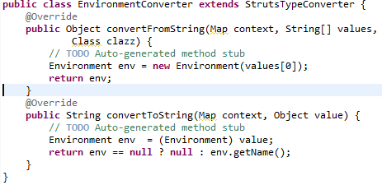
Struts 2 Type Conversion
How to make your own Converter?
Extend org.apache.struts2.util.StrutsTypeConverter and override convertFromString() and convertToString() methods
Register the custom Converter
Per Action Class: [action-class]-conversion.properties
[object-instance-name]=[converter-class]
Global: xwork-conversion.properties
[own-object]=[converter-class]

Slide 38
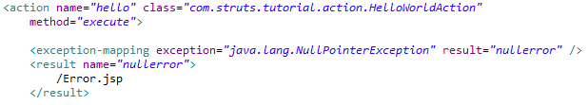
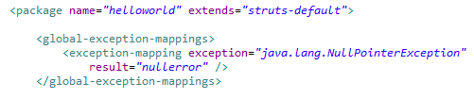
Struts 2 Exception Handling
Struts uses “exception” interceptor (part of the default-stack) for uncaught exception handling
Action-specific
Global Exception Mapping
Notes:
Struts provides an easier way to handle uncaught exception and redirect users to a dedicated error page. You can easily configure Struts to have different error pages for different exceptions. Struts makes the exception handling easy by the use of the "exception" interceptor. The "exception" interceptor is included as part of the default stack, so you don't have to do anything extra to configure it. It is available out-of-the-box ready for you to use.

Slide 39
Struts 2 Annotations
Struts 2 provides an alternative to using XML to configure your application by using standard naming conventions and annotations for your action names, ActionSupport classes, and results
Convention plugin contains a number of Annotations to override the default convention that are used to map actions to URLs and results location

Slide 40
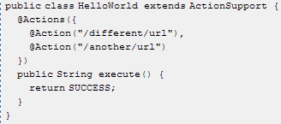
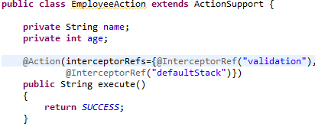
Struts 2 Annotations
@Action, @Actions
@Action is used to control the URL that maps to a specific method in an Action class. It allows developers to change the URL or invoke a different method.
@Actions annotation allows for multiple @Action annotations to be used on a single method
Notes:
Another usage of the Action or Actions annotation is to define multiple action methods within a single action class, each of which respond to a different URL.
Interceptor and interceptor stacks can be specified using the interceptorRefs attribute. The example applies validation interceptor and the defaultStack interceptor stack.
Interceptors can be specified at the method level, using the Action annotation or at the class level using the InterceptorRefs annotation
Example:
@InterceptorRefs({
@InterceptorRef("logger"),
@InterceptorRef("timer"),
@InterceptorRef("defaultStack")
})
public class EmployeeAction extends ActionSupport {
...
}

Slide 41
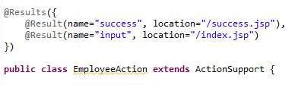

Struts 2 Annotations
@Result, @Results
@Result is used to specify non-convention based results for the Struts convention handling
@Result can also be used inside an @Action annotation on specific methods
@Results annotation allows a class to define more than one Result annotations

Slide 42
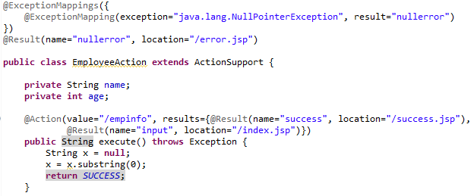
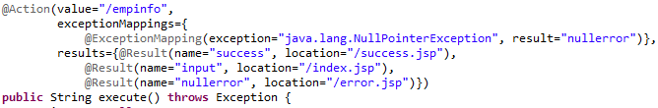
Struts 2 Annotations
@ExceptionMapping, @ExceptionMappings
@ExceptionMapping adds an exception mapping to an action
@ExceptionMappings annotation allows a class to define more than one @ExceptionMapping annotations

Slide 43


Struts 2 Annotations
@RequiredStringValidator
checks that a String field is not empty (i.e. non-null with a length > 0)
annotation must be applied at method level
@IntRangeFieldValidator
checks that a numeric field has a value within a specified range
annotation must be applied at method level

Slide 44
Struts 2 Annotations
org.apache.struts2.convention.annotation
Action, Actions, DefaultInterceptorRef, ExceptionMapping, ExceptionMappings, InterceptorRef, InterceptorRefs, Namespace, Namespaces, ParentPackage, Result, ResultPath, Results
com.opensymphony.xwork2.validator.annotations
ConditionalVisitorFieldValidator, ConversionErrorFieldValidator, CustomValidator, DateRangeFieldValidator, DoubleRangeFieldValidator, EmailValidator, ExpressionValidator, FieldExpressionValidator, IntRangeFieldValidator, RegexFieldValidator, RequiredFieldValidator, RequiredStringValidator, StringLengthFieldValidator, UrlValidator, Validation, ValidationParameter, Validations, VisitorFieldValidator
com.opensymphony.xwork2.interceptor.annotations
After, Allowed, Before, BeforeResult, BlockByDefault, Blocked, InputConfig

Slide 45
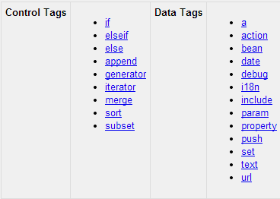
Struts 2 Tags
Generic Tags – control the execution flow as pages render
Notes:
http://struts.apache.org/release/2.1.x/docs/tag-reference.html

Slide 46
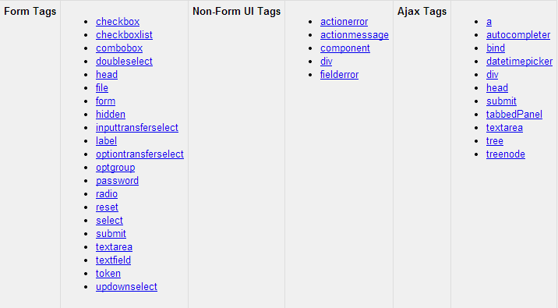
Struts 2 Tags
UI Tags - display data in rich and reusable HTML
Notes:
http://struts.apache.org/release/2.1.x/docs/tag-reference.html

Slide 47

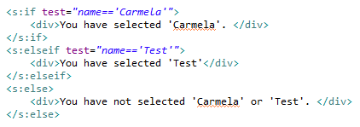

Struts 2 Tags
Control Tags
to control the flow of page execution
Notes:
<s:if>, <s:elseif> and <s:else> - perform basic condition flow found in every language
<s:iterator> - will iterate over a value. An iterable value can be any of: java.util.Collection, java.util.Iterator.
<s:sort> - sorts a List using a Comparator both passed in as the tag attribute
<s:subset> - takes an iterator and outputs a subset of it. It delegates to org.apache.struts2.util.SubsetIteratorFilter internally to perform the subset functionality
<s:append> - tag take two or more lists as parameters and append them all together. Appending lists A and B with values A1,A2 and B1,B2 will result a consolidated list with values A1,A2,B1,B2
<s:merge> - tag take two or more lists as parameters and merge them all together. Merging two lists A and B with values A1,A2 and B1,B2 will result a consolidated list with values A1,B1,A2,B2
<s:generator> - generates an iterator based on the val attribute supplied

Slide 48


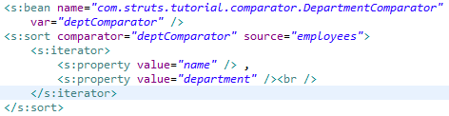
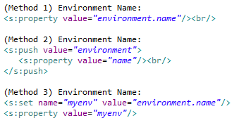
Struts 2 Tags
Data Tags
used to manipulate the data displayed on a page
Notes:
<s:a> - creates a HTML <a >
<s:debug> - Outputs the content of the Value Stack
<s:action> - enables developers to call actions directly from a JSP page by specifying the action name and an optional namespace
- "executeResult" parameter set to “true” will render the result directly in the view. If set to “false”, will make use of the request attributes exposed by the action method
<s:include> - used to include a JSP file in another JSP page
<s:bean> - instantiates a class that conforms to the JavaBeans specification
<s:date> - to format a Date in a quick and easy way
<s:property> - used to get the property of a value, which will default to the top of the stack if none is specified
<s:param> - used to parameterize other tags
<s:push> - used to push value on stack for simplified usage
<s:set> - assigns a value to a variable in a specified scope. It is useful when you wish to assign a variable to a complex expression and then simply reference that variable each time rather than the complex expression.
<s:text> - a generic tag that is used to render a I18n text message
<s:url> - used to create a URL

Slide 49
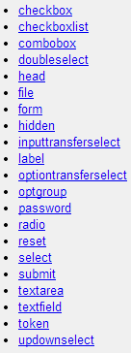

Struts 2 Tags
Form Tags
Subset of Struts UI tags
Help in rendering user interface required for the Struts Web Application
These tags are common HTML tags with an additional prefix s: along with tags and different attributes
Non-Form UI Tags

Slide 50
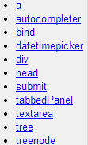
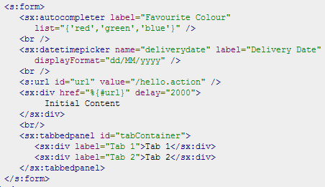
Struts 2 Tags
Ajax Tags
Struts uses the DOJO framework for the AJAX tag implementation (struts2-dojo-plugin-x.y.z.jar)
Add new tag library: <%@ taglib prefix="sx" uri="/struts-dojo-tags"%>

Slide 51
Struts 2 – Hibernate Integration
Hibernate is a high-performance Object/Relational persistence and query service which is licensed under the open source GNU Lesser General Public License (LGPL)
Additional JARs Required:
Struts-Hibernate Plug-in
Hibernate (Including Annotations)
DOM4J
JTA
SLF4J
Create hibernate.cfg.xml
Extend hibernate-default package in struts.xml

Slide 52
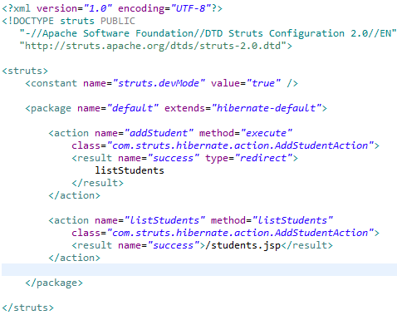
Struts 2 – Hibernate Integration
struts.xml
Notes:
Extend hibernate-default package from the struts-hibernate plugin. hibernate-default extends struts-default

Slide 53
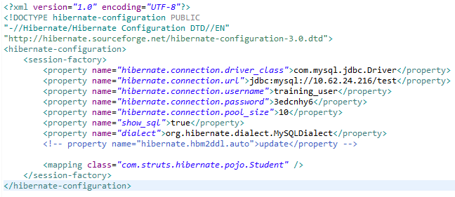
Struts 2 – Hibernate Integration
hibernate.cfg.xml

Slide 54
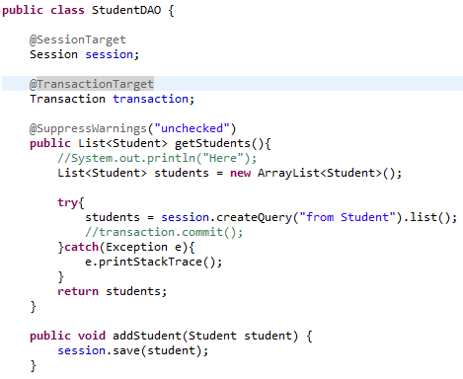
Struts 2 – Hibernate Integration
Session/Transaction

Slide 55
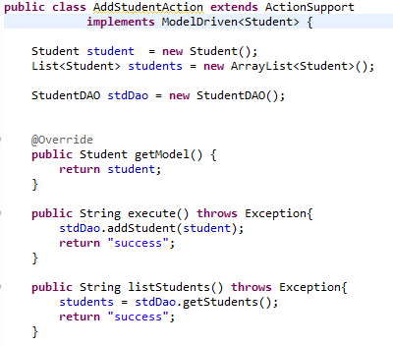
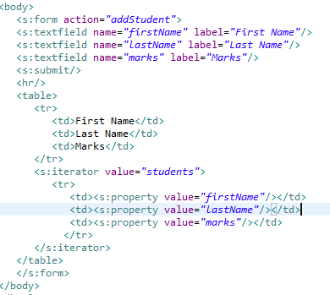
Struts 2 – Hibernate Integration
Action Class / JSP View
Notes:
ModelDriven Interface - an Action interface which provides a model object to pushed in to the value object in addition to action. In order to create a model driven action your class should extend ActionSupport class and also implement the ModelDriven interface. The Model driven interface provides a single method getModel() this allows the model to be pushed into the value stack instead of action itself.

Slide 56
Struts-Tiles Integration
Apache Tiles is a templating framework built to simplify the development of web application user interfaces
Tiles allows authors to define page fragments which can be assembled into a complete page at runtime
JARs
Apache Tiles: tiles-api-x.y.z.jar, tiles-compat-x.y.z.jar, tiles-core-x.y.z.jar, tiles-jsp-x.y.z.jar, tiles-servlet-x.y.z.jar
Struts: commons-beanutils-x.y.z.jar, commons-digester-x.y.z.jar, struts2-tiles-plugin-x.y.z.jar

Slide 57
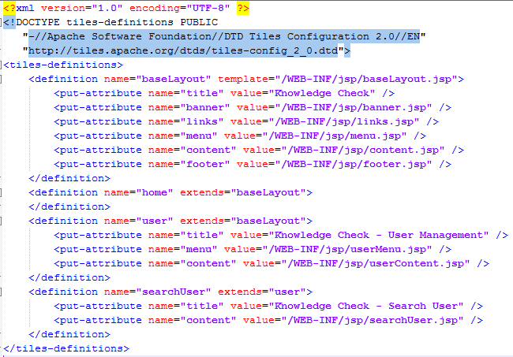
Struts-Tiles Integration
tiles.xml

Slide 58
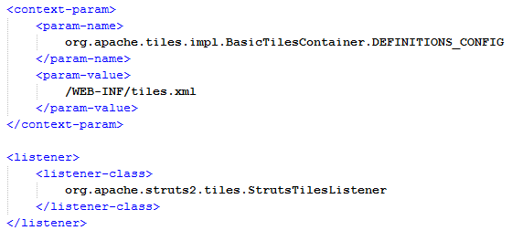
Struts-Tiles Integration
web.xml

Slide 59
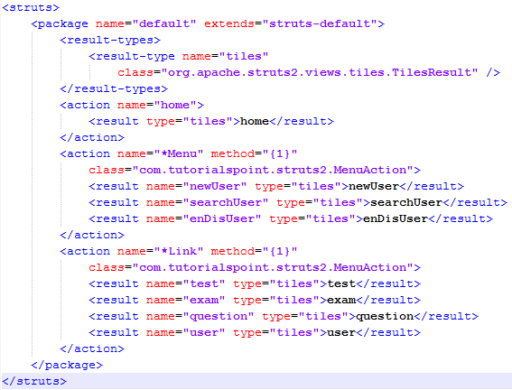
Struts-Tiles Integration
struts.xml - Result/Result Type

Slide 60

Struts-Tiles Integration
JSP

Slide 61
Exercise
Day 2
Day 3

Slide 62
Thank You For Your Time
Notes:
Sources:
http://www.tutorialspoint.com/struts_2/index.htm
http://struts.apache.org/release/2.2.x/
http://freemarker.org/
http://tiles.apache.org/

